Slide 1
20IT603L – Mini Project-I
WIFI ENABLED ICU PATIENT MONITORING SYSTEM
TEAM MEMBERS:
GUIDE:
Aarthee U K (621322205001)
Mrs. R. ARUNA,AP/IT
Monisha B (621322205034)
Shahira begam A (621322205045)
1
1

Slide 2
TABLE OF CONTENTS
S.NO | TOPIC | Page. No
1. | Abstract | 4
2. | Introduction | 5
3. | Literature survey | 6
4. | Existing system | 7
5. | Proposed system | 8
6. | Solution Architecture | 9
7. | Modules split-up | 11
8. | Algorithm used | 14
9. | System Requirement | 15
10. | Code Implementation | 16
11. | Expected Output | 17
2

Slide 3
TABLE OF CONTENTS
S.NO | TOPIC | Page. No
13. | System Requirements | 15
14. | Code Implementation | 16
16. | Expected Outcomes | 17
17. | Conclusion | 18
18. | Reference | 19
3

Slide 4
ABSTRACT
In Intensive Care Units (ICUs), continuous monitoring of patients' vital signs is crucial for timely medical intervention. Traditional monitoring systems often require patients to be physically connected to monitoring devices, which can be uncomfortable and limit their mobility.
This project proposes a Wi-Fi based ICU patient monitoring system that allows for wireless transmission of patients' vital signs, such as heart rate, temperature to a central monitoring station. The system aims to enhance patient comfort, improve the efficiency of healthcare delivery, and ensure real-time monitoring and alerting for critical conditions.
4

Slide 5
INTRODUCTION
Traditional ICU patient monitoring systems are often cumbersome due to the need for wired connections between patients and monitoring devices. These systems can limit patient mobility, cause discomfort, and pose challenges in terms of scalability and real-time data accessibility. There is a need for a more flexible, efficient, and patient-friendly monitoring solution that leverages modern wireless technology to provide continuous and reliable monitoring of patients' vital signs.
5

Slide 6
LITERATURE SURVEY
S-no | Author & Year of Publication | Journal | Title of the paper | Advantages &Limitations
1. | Itamir de Morais Barroca Filho, Gibeon Aquino, Ramon Santos Malaquias, Gustavo Girão, Sávio Rennan Menêzes Melo / IEEE Access (2021) | Conference on Emerging Devices and Smart Systems (ICEDSS) | “An IoT-Based Healthcare Platform for Patients in ICU Beds During the COVID-19 Outbreak” | Advantages: This platform can help in tracking vital signs, managing medication. Limitations: It does not provide a detailed analysis of the technical aspects of the platform, such as the communication protocols, security measures, and data storage.
2. | Sai Srinivas Vellela / International Journal for Modern Trends in Science and Technology (2024) | International Journal of Latest Trends in Engineering and Technology, (IJLTET) | "IoT Based ICU Patient Monitoring System" | Advantage: Reducing the workload of healthcare professionals by automating some tasks, such as recording vital signs and generating alerts when necessary. Limitations: The cost of implementing and maintaining the IoT-based ICU patient monitoring system can be high.

Slide 7
EXISTING SYSTEM
The existing patient monitoring systems in Intensive Care Units (ICUs) primarily rely on wired devices to continuously track vital signs such as heart rate, temperature, and humidity. These systems involve attaching sensors directly to the patient's body, which are connected via cables to bedside monitors. While effective in providing real-time data to healthcare professionals, these traditional systems can cause discomfort and restrict patient movement due to the physical constraints of the cables and devices. Additionally, the reliance on wired connections can limit the scalability of monitoring and complicate patient care logistics, especially in situations requiring frequent repositioning or transportation of patients.
7

Slide 8
PROPOSED SYSTEM
The proposed system consists of three main components:
Sensor Modules: These modules are equipped with sensors to measure patients' vital signs such as heart rate, body temperature, and humidity. Each sensor module is connected to a microcontroller with a Wi-Fi module for wireless data transmission.
Wi-Fi Network: A robust Wi-Fi network ensures reliable and continuous data transmission from the sensor modules to the central monitoring station.
Monitoring Station: This station receives the data transmitted from the sensor modules. It includes a computer or server with software that processes and visualizes the data in real-time. The software also includes an alert system to notify healthcare professionals of any critical changes in patients' conditions.
.
8

Slide 9
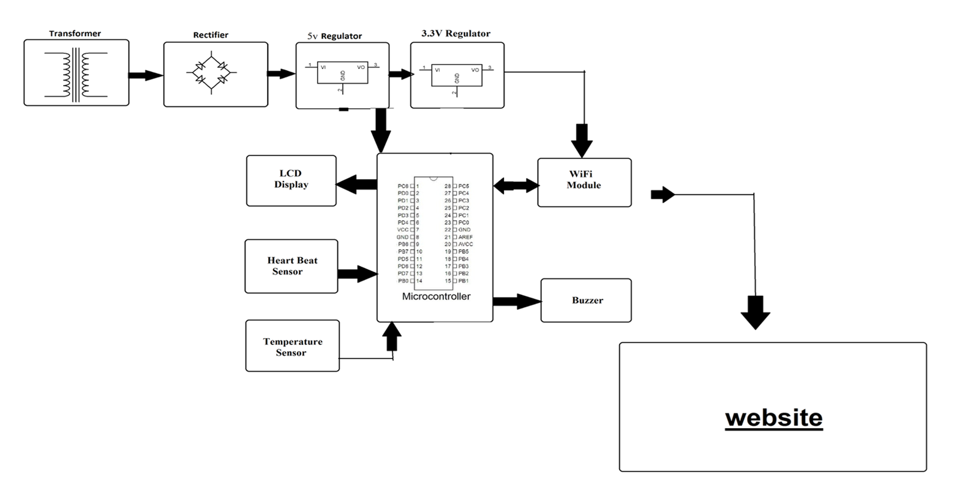
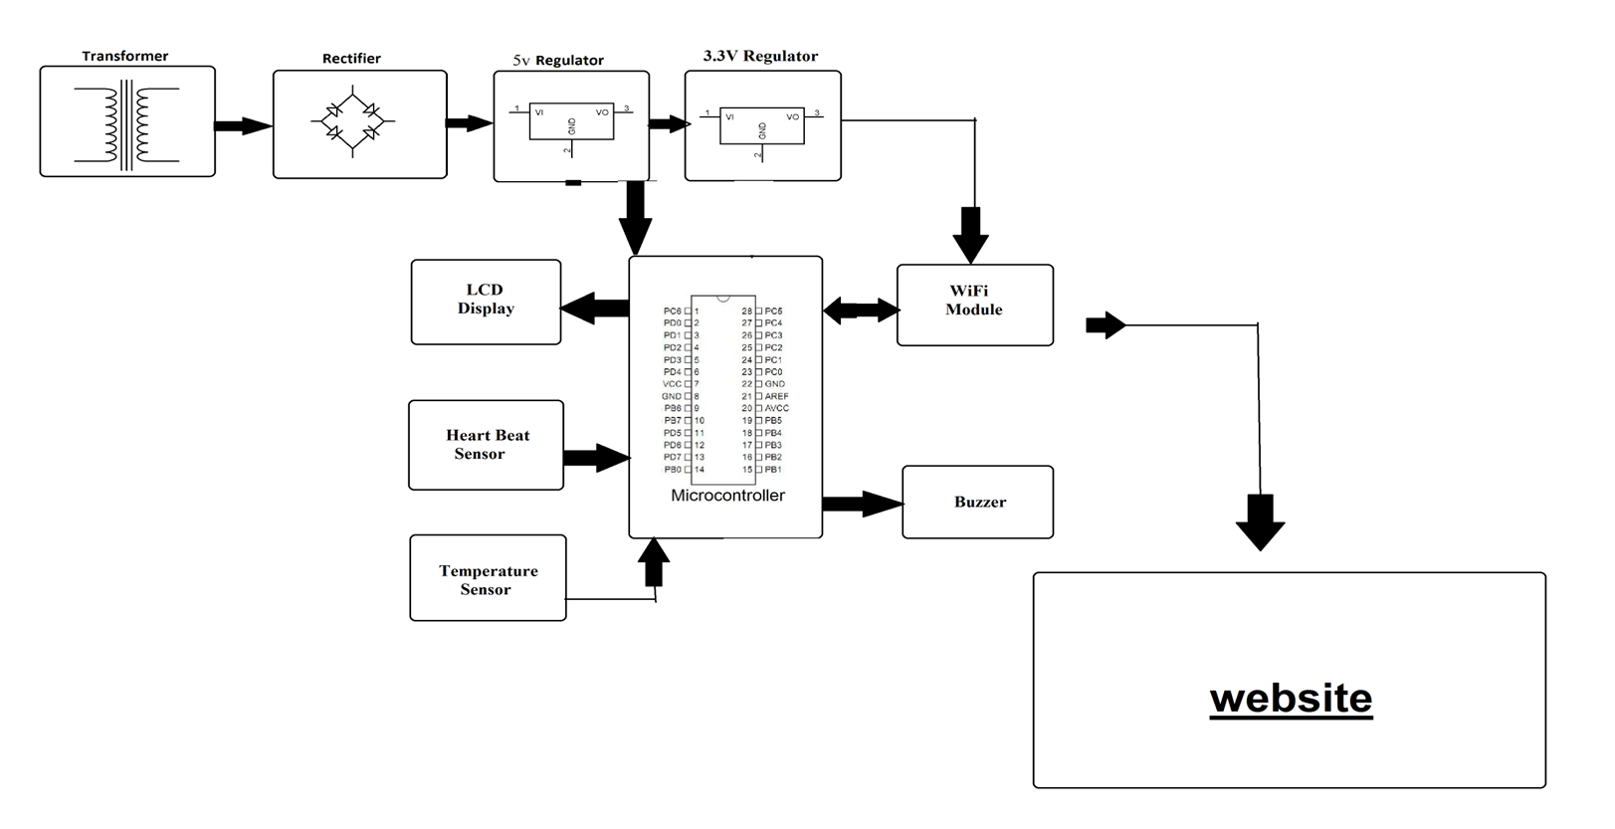
SOLUTION ARCHITECTURE
9

Slide 10
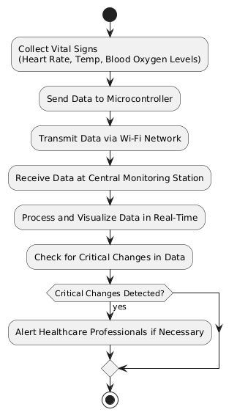
FLOW CHART
10

Slide 11
MODULES SPLIT-UP
1. Patient Monitoring and Data Acquisition Module:
Components: Heart rate sensor, temperature sensor, blood oxygen (SpO2) sensor, microcontroller.
Function: This module is responsible for the real-time acquisition of vital signs from the patient. It includes the sensors that measure heart rate, body temperature, and blood oxygen levels, as well as the microcontroller that processes the sensor data.
Objective: To ensure accurate, continuous, and non-intrusive monitoring of patient vitals with minimal discomfort..

Slide 12
MODULES SPLIT-UP
2. Wireless Data Transmission and Central Monitoring Module:
Components: Wi-Fi transceiver, central server, data processing unit, user interface (UI).
Function: This module handles the wireless transmission of vital signs data from the patient to a central monitoring station. It ensures that data is securely and reliably transmitted in real-time. The central server processes and displays this data on a user-friendly interface for healthcare professionals to monitor and respond to.
Objective: To provide seamless and secure communication between the patient and the central system, ensuring healthcare providers can monitor patients in real-time and receive alerts for any critical conditions.

Slide 13
MODULES SPLIT-UP
3. Data Management, Alerting, and Security Module:
Components: Database management system, alert algorithms, encryption protocols, cloud storage (optional).
Function: This module is responsible for storing, managing, and securing the collected data. It includes generating alerts and notifications based on abnormal readings and ensuring data privacy through encryption and secure protocols. It also manages long-term storage, allowing historical data retrieval and compliance with healthcare data regulations.
Objective: To ensure that patient data is stored securely, alerts are generated promptly for critical conditions.

Slide 14
ALGORITHM USED
MQTT (Message Queuing Telemetry Transport) Protocol: An efficient lightweight messaging protocol designed for small sensors and mobile devices, ensuring reliable data transmission in IoT systems.
Publish-Subscribe Model: Unlike the traditional request-response model, MQTT uses a publish-subscribe architecture, where devices (publishers) send messages on a specific topic, and other devices (subscribers) receive messages on topics they are interested in. This model decouples the sender and receiver, which makes the system more flexible and scalable.
Lightweight: MQTT has a very small code footprint and minimal network bandwidth usage, making it ideal for environments with limited resources, IoT devices.

Slide 15
SYSTEM REQUIREMENTS
Hardware Requirements:
Heart Beat sensor
Temperature Sensor
ESP8266
Microcontroller
Power Supply
Software Requirements:
Arduino IDE
Embedded C
Server

Slide 16
CODE IMPLEMENTATION
#include <ESP8266WiFi.h>
#include <DHT.h>
#include <WiFiClientSecure.h>
#define DHTPIN 4 // Pin where the DHT sensor is connected
#define DHTTYPE DHT11 // Change to DHT22 if you're using that
#define LDRPIN A0 // Pin where the LDR is connected
const char* ssid = "Shahisha073"; // Replace with your WiFi SSID
const char* password = "shahira7"; //kindly enter your pass check ssid and pass is correct is it corrtct?
//yes correct
const char* serverUrl = "iot.pythonanywhere.com"; // Your API endpoint without "https://"
// Create a DHT object
DHT dht(DHTPIN, DHTTYPE);
void setup() {
Serial.begin(115200);
dht.begin();
// Connect to WiFi
WiFi.begin(ssid, password);
while (WiFi.status() != WL_CONNECTED) {
delay(500);
Serial.print(".");
}
Serial.println("Connected to WiFi");
}
.
.
void loop() {
// Read temperature and humidity
float temperature = dht.readTemperature();
float humidity = dht.readHumidity();
// Read LDR value
int ldrValue = analogRead(LDRPIN);
// Check if any reads failed
if (isnan(temperature) || isnan(humidity)) {
Serial.println("Failed to read from DHT sensor!");
delay(10000); // Wait before retrying
return;
}
// Create JSON payload
String jsonPayload = String("{\"temperature\":") + temperature +
",\"humidity\":" + humidity +
",\"hb\":" + ldrValue + "}";
.

Slide 17
CODE IMPLEMENTATION
.
// Send HTTPS POST request
if (WiFi.status() == WL_CONNECTED) {
WiFiClientSecure client; // Create WiFiClientSecure object
client.setInsecure(); // Use this for testing; for production, use a proper certificate
// Begin connection
if (client.connect(serverUrl, 443)) { // Port 443 for HTTPS
// Create HTTP POST request
client.println("POST /data HTTP/1.1");
client.println("Host: " + String(serverUrl));
client.println("Content-Type: application/json");
client.print("Content-Length: ");
client.println(jsonPayload.length());
client.println("Connection: close");
client.println(); // End of headers
client.println(jsonPayload); // Send the JSON payload
.
// Wait for response
while (client.connected() || client.available()) {
if (client.available()) {
String line = client.readStringUntil('\n');
Serial.println(line); // Print response from server
}
}
} else {
Serial.println("Connection failed");
}
// Close the connection
client.stop();
} else {
Serial.println("WiFi Disconnected");
}
delay(10000); // Send data every 10 seconds
}
.

Slide 18
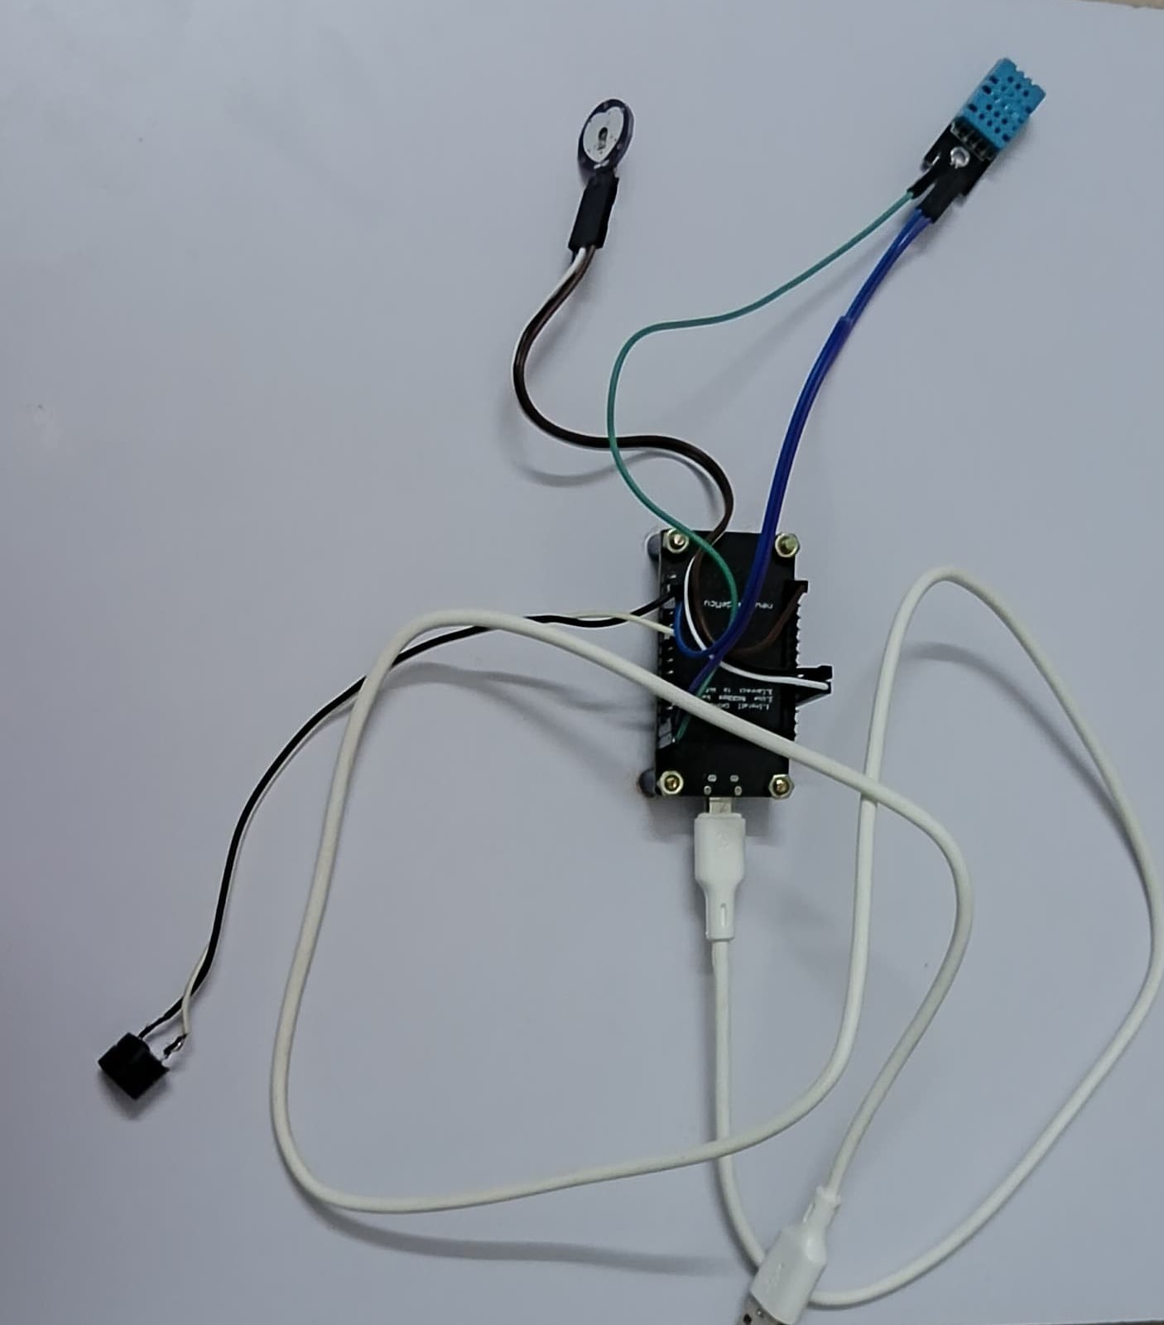
EXPECTED OUTPUT
.

Slide 19
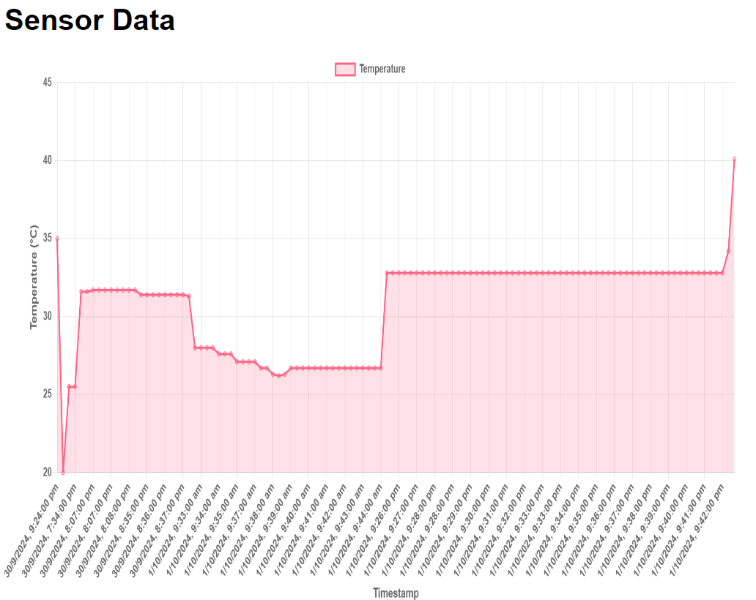
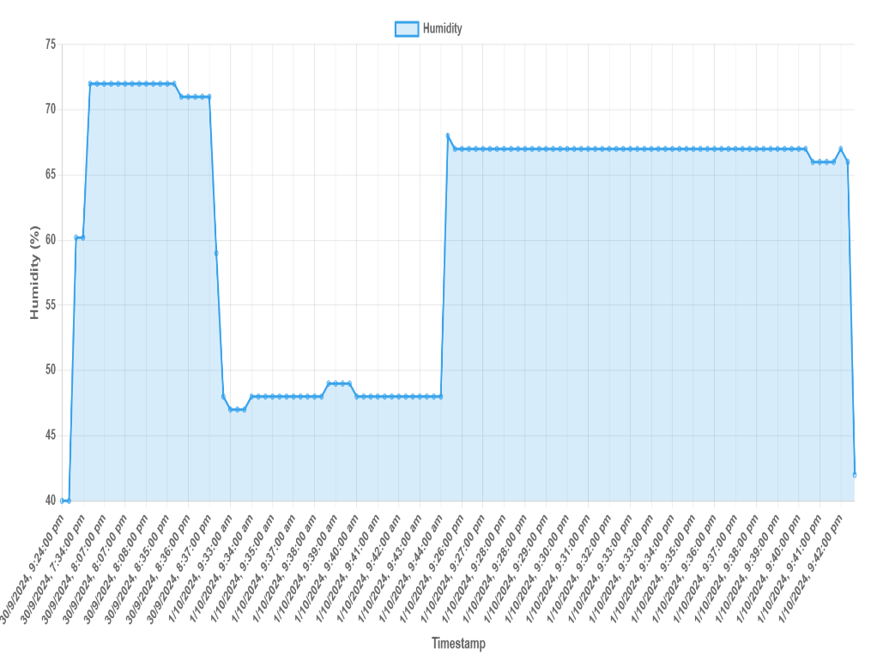
EXPECTED OUTPUT
.

Slide 20
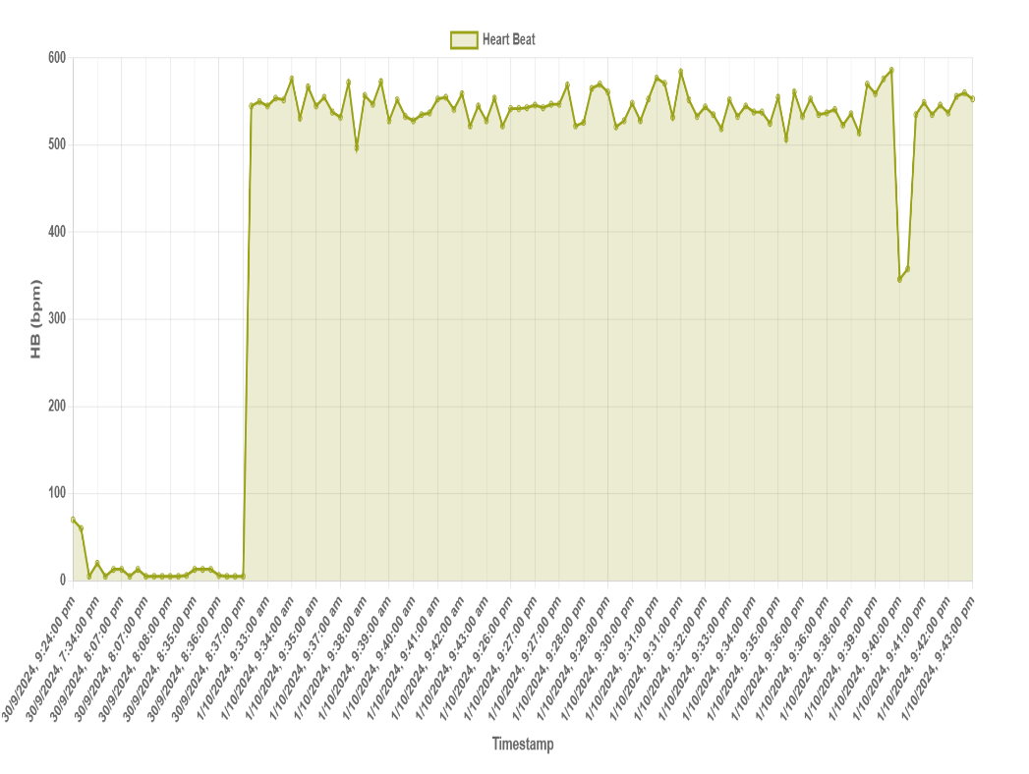
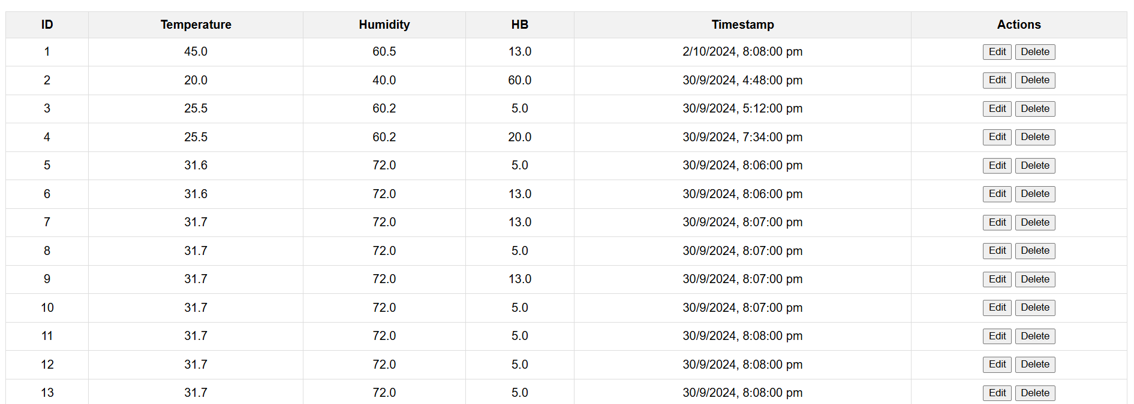
EXPECTED OUTPUT
.

Slide 21
CONCLUSION
The Wi-Fi based ICU patient monitoring system presents a significant advancement over traditional wired systems, offering enhanced patient comfort, mobility, and real-time data accessibility. By leveraging modern wireless technology, the proposed system ensures continuous monitoring of vital signs and timely medical intervention in critical situations. The successful implementation of this system can improve the efficiency of healthcare delivery in ICUs, ultimately leading to better patient outcomes. Future work will focus on optimizing the system for scalability, security, and integration with existing hospital information systems.

Slide 22
REFERENCE
[1] Farhan Ishtiaque, Sadman Rahman Sadid, Mohammed Shihab Kabir, Syeda Omia Ahalam, Md. Sharjis Ibne Wadud. "IoT-Based Low-cost Remote Patient Monitoring and Management system with Deep Learning-Based Arrhythmia and Pneumonia detection." 2021 IEEE 4th International Conference on Computing, Power and Communication Technologies (GUCON), 2021.
[2] Mily Lal, Manisha Bhende, Akanksha Goel, Abha Pathak, Poi Tamrakar, Swati Sharma, Pallavi Thorat. "Enhancing Patient Care and Monitoring Through AI and IoT in Healthcare." 2023 IEEE International Conference on Computer Vision and Machine Intelligence (CVMI), 2023.
[3] R. Kiruthika, E. Ramya, R. Prabha, M. Harinarayanan, S. Divakaran, R. Iswariya. "IoT Based Patient Monitoring System." 2022 8th International Conference on Advanced Computing and Communication Systems (ICACCS), 2022.
[4] V. P. Kavitha, G. Theivanathan, V. Magesh, Jayandhi G. "A Comprehensive Survey of IoT Applications in Remote Patient Monitoring, Chronic Disease Management, and Smart Healthcare Infrastructure." 2024 3rd International Conference on Sentiment Analysis and Deep Learning (ICSADL), 2024.

Slide 23
THANK YOU!!!

